Slide 1

AtliQ Hardware Sales Analytics
Notes:
Hello, I'm Ramya. I’m here to present a project from the AtliQ Hardware sales analytics team, providing insightful data for smart decision-making and to find the areas of improvement. Without any further delay, let's begin the presentation.

Slide 2

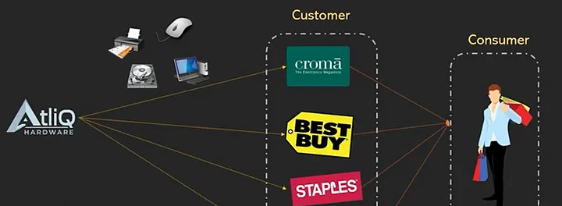
AtliQ Hardware Business Model
AtliQ Hardware is a company that sells gadgets to different customers like
Croma
Best Buy
Amazon
Staples
Notes:
AtliQ is a company that sells hardware like PC , Mouse, printers and so on to different customers. They make hardware and sell their products to big customers like Croma, Best Buy, Staples and even for online customers like Amazon and flipkart. These stores sell the hardware to the end consumers who purchases things for their personal use

Slide 3

Objective
This project, aims to help AtliQ Hardware's sales team make smart decisions by creating easy-to-understand Excel reports.
Guide Smart Choices
Use Data for Growth
Check Performance
Notes:
The main goal of this project is to help AtliQ Hardware's sales team make smart decisions by creating easy-to-understand Excel reports.
Guide them to make Smart Choices: Give the team insights to make clever decisions that will grow the business and make AtliQ Hardware known all around the world.
Use the Data for Growth: Analyse data to find where the business can grow, understand market trends, and suggest places to expand, ensuring a strong presence globally.
And Check the Performance: Make reports that show how well the team is doing, highlighting strengths, finding areas to improve, and making sure everything runs smoothly.

Slide 4

Purpose of analyzing Net Sales Performance and Market vs. Target
Net sales performance:
Analyzing Net Sales Performance from 2019 to 2021 helps us see how well AtliQ Hardware is doing and understand if sales are going up or down in different countries.
Market vs. Target:
Market vs. Target analysis helps make sure AtliQ Hardware's sales match the goals we set.
Notes:
Net sales performance
Analyzing Net Sales Performance from 2019 to 2021 helps us see how well AtliQ Hardware is doing and understand if sales are going up or down in different countries. This analysis gives us smart insights for future decisions, like choosing which products to focus on and where to allocate resources.
Market vs. Target
Market vs. Target analysis helps make sure AtliQ Hardware's sales match the goals we set. And check how each country is doing compared to sales targets, find areas of success or improvement, and make smart decisions on where to adjust strategies for better results.

Slide 5

Net Sales Performance Report (2019-2021)
Notes:
Lets look into the net sales performance report

Slide 6
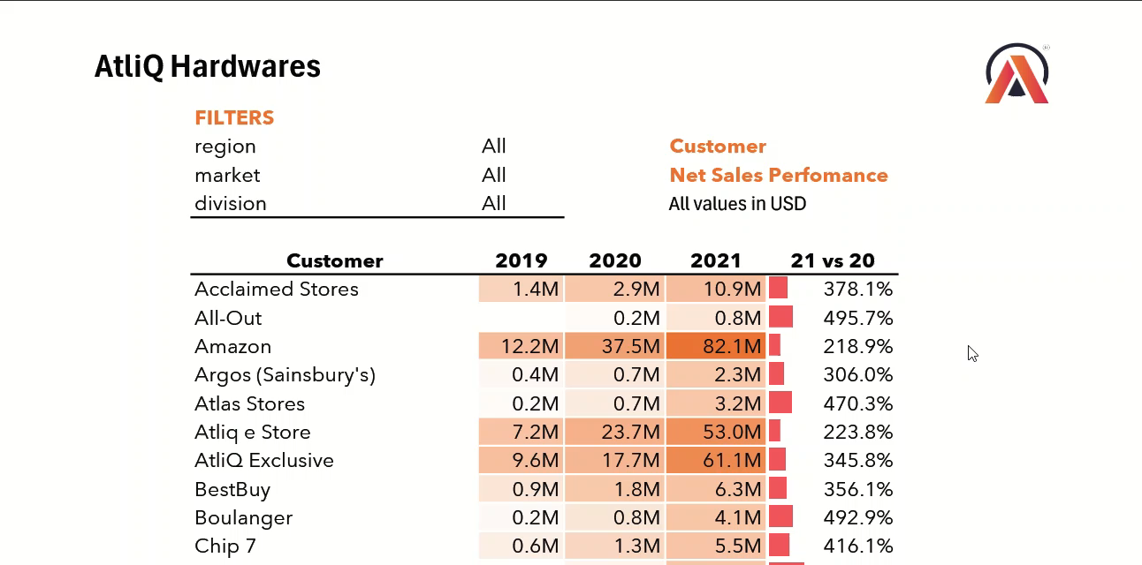
Notes:
This report contains customer net sale values of 2019, 2020 and 2021 and as well as the comparison of 2021 vs 2020. The net sales values are visually highlighted using a gradient shading from light to dark and specifically used data bars for 21 vs 20 comparison offering a clear representation of sales trends.

Slide 7

Market Performance Report (2019-2021)
Notes:
Moving to the Market performance report

Slide 8
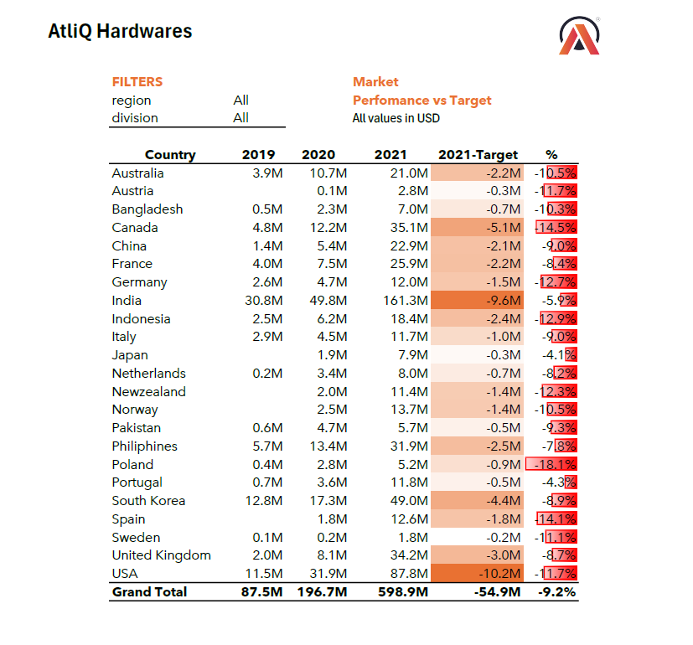
Notes:
This slide provides a breakdown of country-wise values for the years 2019, 2020, and 2021, including the respective target values for 2021 and the corresponding percentage achievement against the targets.The target values are negative indicating that targets were not met in many countries even though the net sale values shows positive performance. This happens sometimes when the targets are set aggressively.

Slide 9
The top 10 products based on the percentage increase in their net sales from 2020 to 2021
Notes:
In this slide, we are presenting the top 10 products that experienced a remarkable percentage increase in net sales from 2020 to 2021. This analysis enables the AtliQ Hardware team to identify the key products driving the sales growth and strategize accordingly for future success.

Slide 10
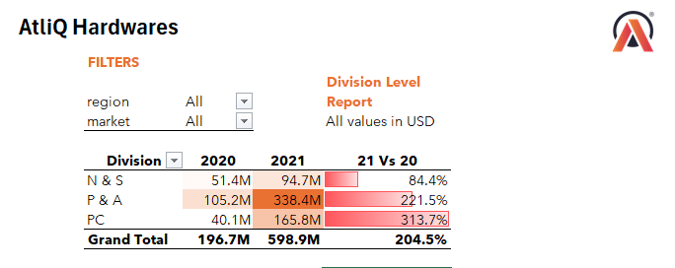
Generate a "Division" report to present the net sales data for 2020 and 2021, along with the growth percentage
Notes:
This slide represents a comprehensive report on the net sales data for different divisions within AtliQ Hardware for the years 2020 and 2021. This table presents the net sales and growth percentages for three different divisions, N & S (Networking & Security) Division:
P & A (Peripherals & Accessories) Division: and
PC (Personal Computing) Division:
The P & A division contributed significantly to the overall sales growth, indicating a strong market demand for peripherals and accessories.
The PC division showed the highest percentage increase, suggesting a notable market acceptance of personal computing products.
The N & S division experienced healthy growth, indicating a positive trend in the networking and security market.

Slide 11
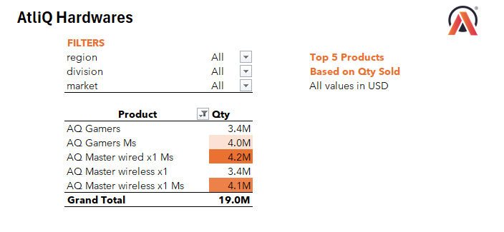
Top 5 products in terms of quantity sold
Notes:
In this slide, we are highlighting the top 5 products based on the quantity sold. This information provides valuable insights into consumer preferences and helps the team to understand which products are driving sales volume.
Gaming-related products dominate the top 5, indicating a strong market demand for gaming accessories.

Slide 12
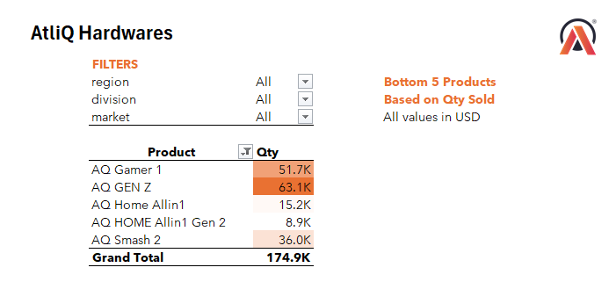
Bottom 5 products in terms of quantity sold
Notes:
This slide highlights the bottom 5 products based on the quantity sold.
Products like "AQ Home Allin 1," "AQ GEN Z," and "AQ Home Allin 1Gen 2" have relatively lower sales volumes, indicating potential challenges in market acceptance.
Evaluate the market response and customer feedback for these products to understand the reasons behind the lower sales.

Slide 13
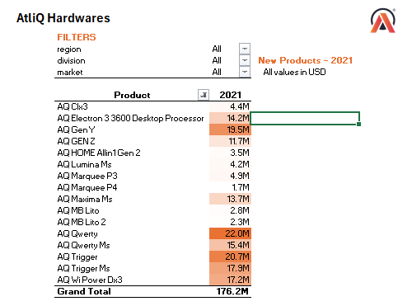
What are the new products that AtliQ began selling in 2021
Notes:
This slide showcases the net sales for the new products that AtliQ introduced in 2021. The sales data provides insights into the performance of these products, helping the AtliQ Hardware team understand which new offerings have been successful in the market.
"AQ Qwerty," "AQ Gen Y," and "AQ Qwerty Ms" emerged as the top-performing new products in terms of net sales.
Focus on promoting and further developing the top-performing products to capitalize on their success.

Slide 14
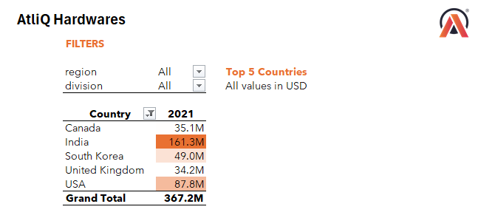
Top 5 countries in terms of net sales in 2021
Notes:
This slide highlights the top 5 countries where AtliQ Hardware achieved the highest net sales in the year 2021.
India emerged as the top contributor to net sales, showcasing its significance as a major market for AtliQ Hardware.
The USA, South Korea, and the United Kingdom also played crucial roles in the company's global net sales.
Allocate resources to meet the high demand in India and the USA.
Analyze consumer behavior and preferences in South Korea to optimize marketing strategies.
Evaluate opportunities for growth and market expansion in Canada and the United Kingdom.
This information helps our team know where to focus, use our resources well, and make special plans for each country so we can sell more and keep growing.

Slide 15

Thank You…
Notes:
Thank You for your time and attention. Stay tuned for Atliq hardware’s finance analytics presentation. Have a good day.

